Slide 1
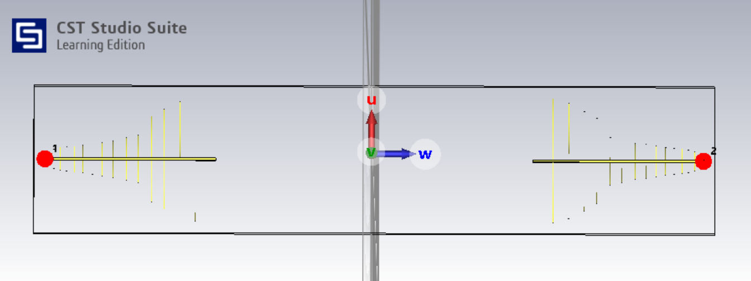
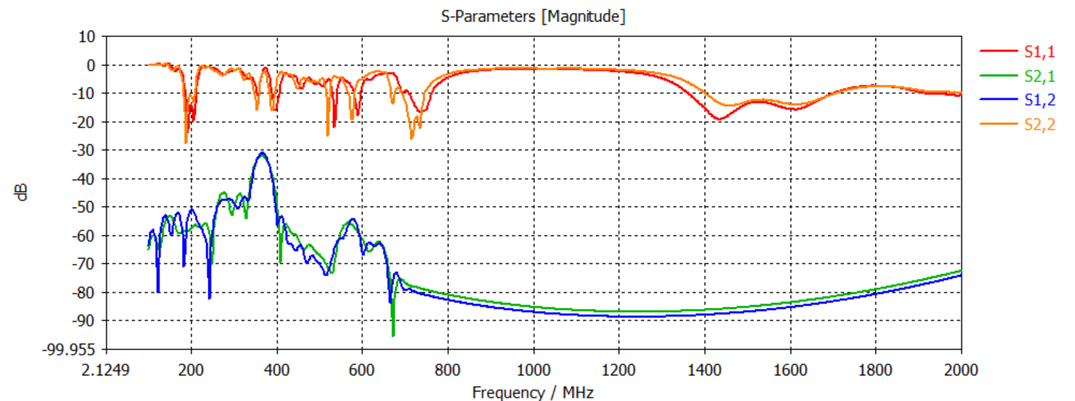
LPDAs placed 180° and 2m apart
LPDAs placed 180° and 2m apart
S11,s22
s11 and s12 is about -60dB from 0 to 400MHz with an abnormally large spike at about 375MHz after which it drops to about -90dB on average.
S12,s21

Slide 2

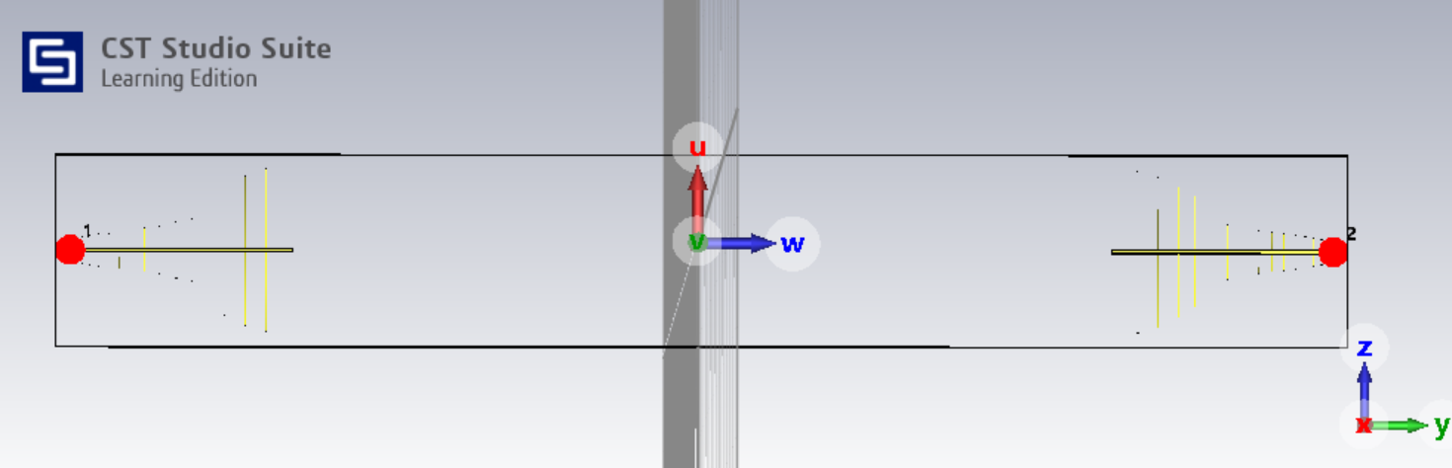
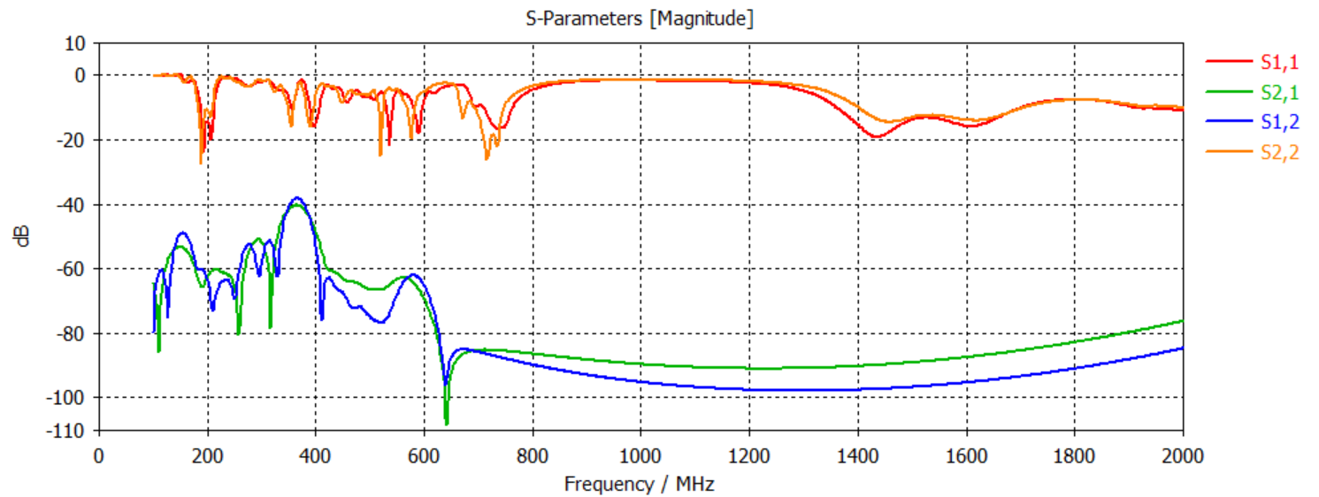
LPDAs placed 180° and 4m apart
LPDAs placed 180° and 4m apart
S11,s22
s11 and s12 is about -60dB from 0 to 400MHz with an smaller abnormally large spike at about 375MHz after which it drops to about -95dB on average.
S12,s21

Slide 3
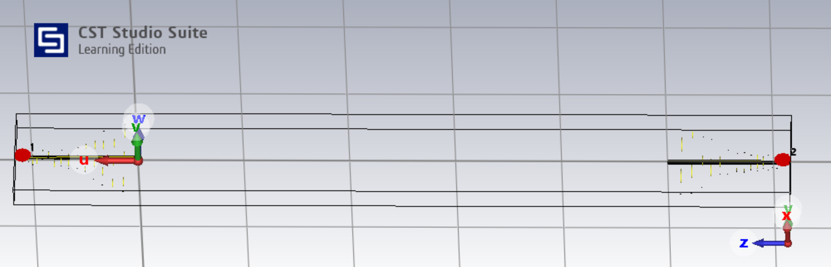
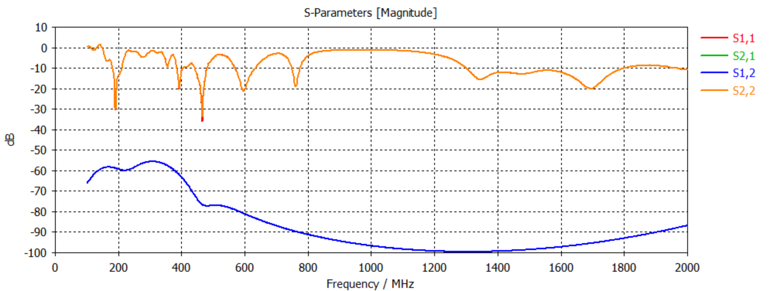
LPDAs placed 180° and 5m apart
LPDAs placed 180° and 5m apart
S11,s22
s11 and s12 is about -60dB from 0 to 400MHz after which it drops to about -95dB on average.
S12,s21

Slide 4
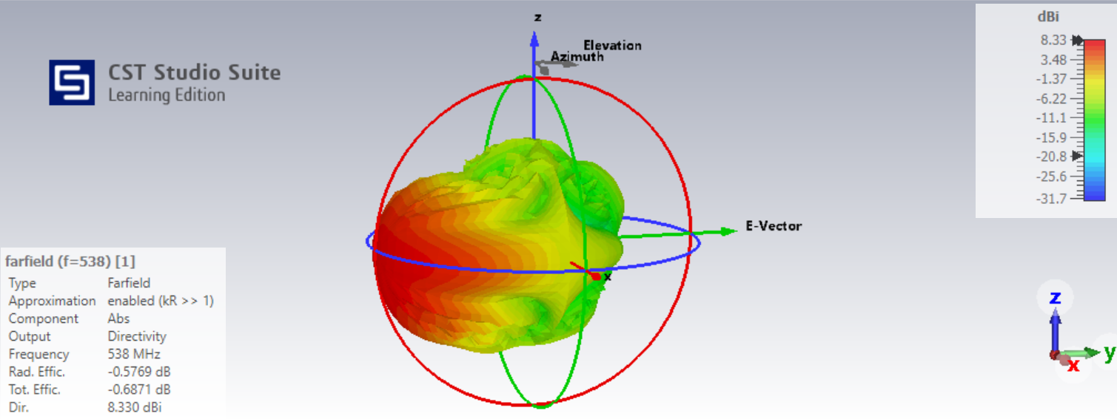
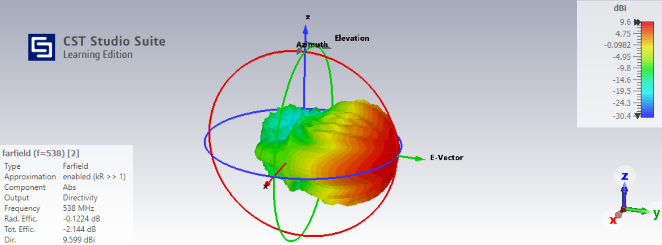
LPDAs placed 180° and 5m apart
Far Field at 538MHz

